Slide 1
Living things

Slide 2
Charactertistics of living things
They all perform the three vital functions (reproduction, nutrition and interaction)
They all are made up of cells.
They all are composed by similar substances

Slide 3
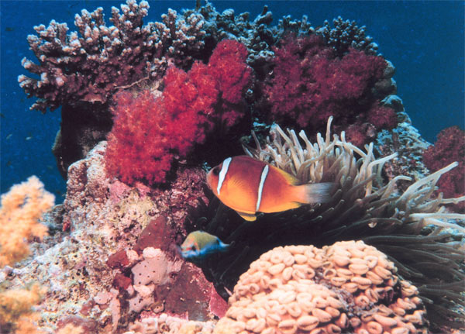

Slide 4
The three vital functions
Nutrition: it is the function by wich living beings obtein matter and energy.
Organisms can perform nutrition in different ways:
Heterotrophic nutrition: living beings obtein their food from other living beings. Animals, Fungi, some Protoktists.
Autotrophic nutrition: Organisms obtein the food from inorganic substances, CO2 from the air, minerals from the soil and water using the energy of the Sun. Plants, some Bacteria and some Protoktists.

Slide 5
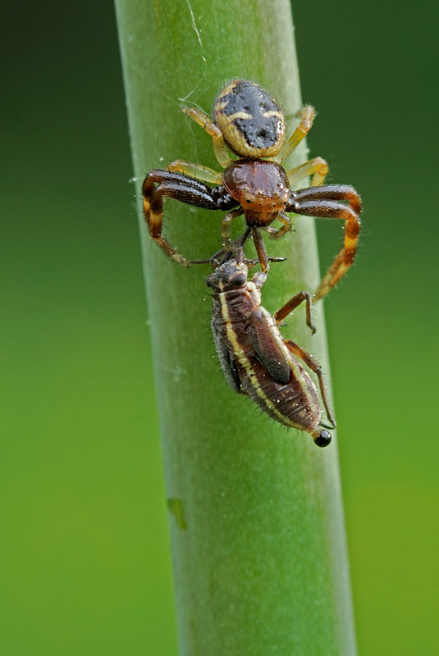
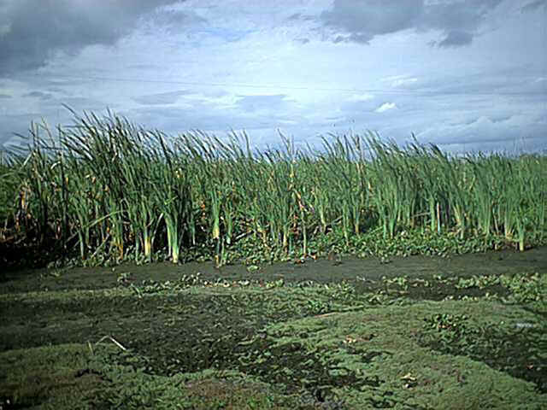
Nutrition

Slide 6
The three vital functions
Interaction: Whit this function, organisms obtain information about the environment and react by producing a response.
Living beings reacts to stimuli like: light, sound, pressure, temperature, humidity, other organisms. Responses: movement, production of chemical substances, etc.

Slide 7
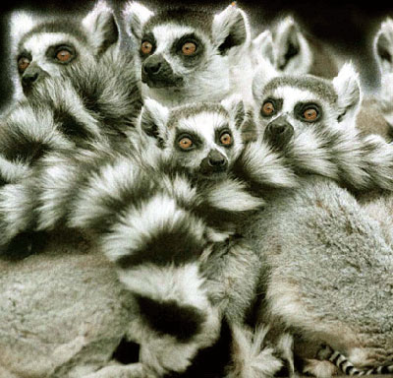
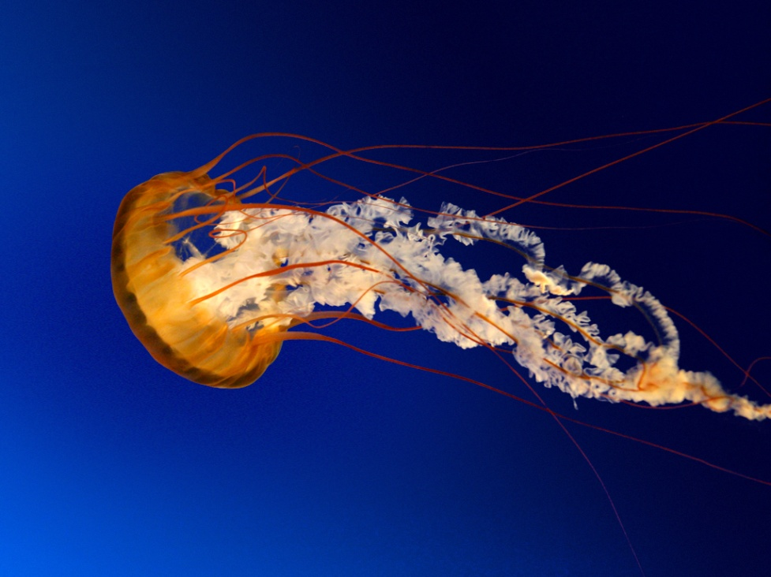
Interaction

Slide 8
The three vital functions
Reproduction:
This functions allows living beings to produce new individuals.
Types:
Asexual: the organism produces copies of itself.
Sexual: Two parents are needed to produce descendents that share the genetic characteristics of them.
Animals lay eggs or give birth to live young, plants produce seeds, bacteria divide into two copies.

Slide 9
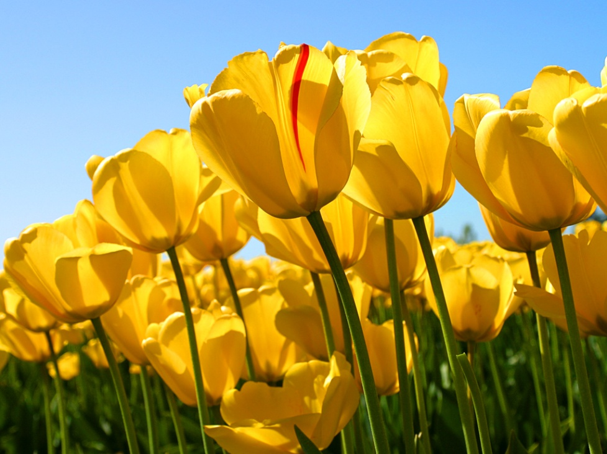
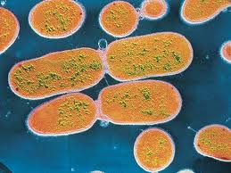
Reproduction

Slide 10
What are living things made up of?
All living things are made up of chemical substance´. The most common elements in living matter are: C, H, O, N , P and S. Combinations of these elementes form molecules called biomolecules.
Organic biomolecules
Inorganic biomolecules

Slide 11
Biomolecules
Inorganic (do not contain Carbon)
Organic: contain Carbon
Water (H2O): chemical reactions, it transports substances.
Mineral salts :make structures, balance internal fluids
Carbohydrates (energy and structure)
Lipids (energy and structure)
Proteins (structures, to fight deseases, to transport O)
Nucleic acids (to carry genetic material)

Slide 12
Cells (CELL THEORY)
Cells are the smallest unit of life. (functional and structural)
All living things are made up of one or more cells.
Cells carry out the 3 vital functions.
All cells come from other cells.

Slide 13
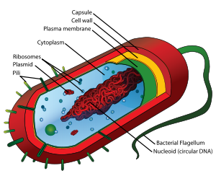
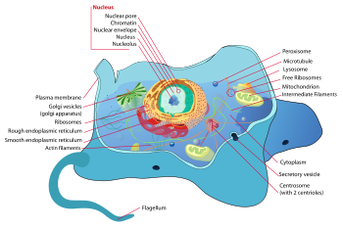
BASIC TYPES OF CELLS
PROKARYOTIC
EUKARYOTIC

Slide 14
Prokaryotic cells
They have no nucleus. Genetic material is dispersed throughout the cytoplasm. They don’t have organelles.
Bacteria are made up of prokaryotic cells.

Slide 15
Eukaryotic cells
Tfrom they have a nucleus that contein the genetic material and it’s separated from the cytoplasm by a membrane.
They contain organelles (mitochondria, vacuoles, chloroplasts,…)
Algae, Protozoa, Fungi, Plants and Animals have eukaryotic cells.

Slide 16
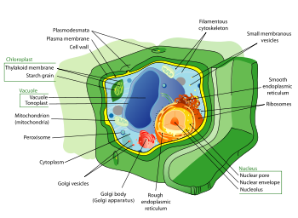
Eukariotic cells
Animal cell
Plant cell

Slide 17
Differences
Animal cell | Plant cell
Plasmatic Membrane | Cell wall
Various shapes | Polyhedral
NO chloroplasts | Chloroplasts
Small vacuoles | Big and unique vacuole

Slide 18
Structure of a eukaryotic cell
Cell membrane: controls what passes in and out
Nucleus: contains genetic material
Cytoplasm: contains the organelles and holds them
Mitochondrium: obteins energy from nutrients by cell respiration
Vacuoles: Store substances, mainly water
Cell wall: thick and rigid it manteins the shape
Chloroplasts: contain chlorophyll wich absorbes the Sun’s energy to produce glucose during photosynthesis.

Slide 19
Classification of living things
Attending to the number of cells:
Unicellular organisms: have only one cell. They sometimes form colonies.
Multicellular organisms: They have many different cells. Cells are organised in levels. The cells work together to carry out the vital functions.

Slide 20
Levels
Cells: specialised, they have specific functions (and shape)
Tissues: groups of cells with the same function and origin and sometimes structure.
Organs: groups of tissues wich act together.
Systems: groups of organs.

Slide 21
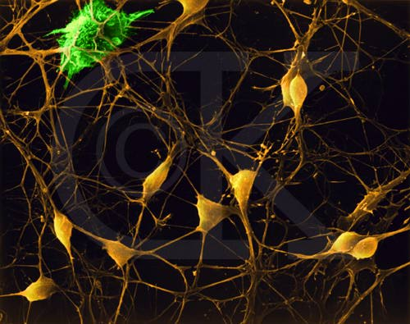
Now guess the level!!

Slide 22
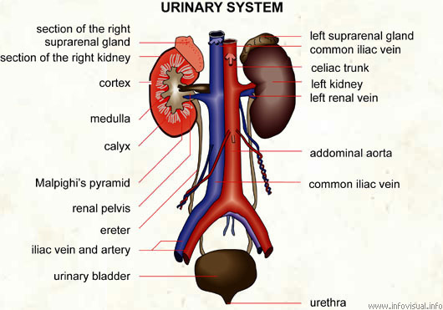
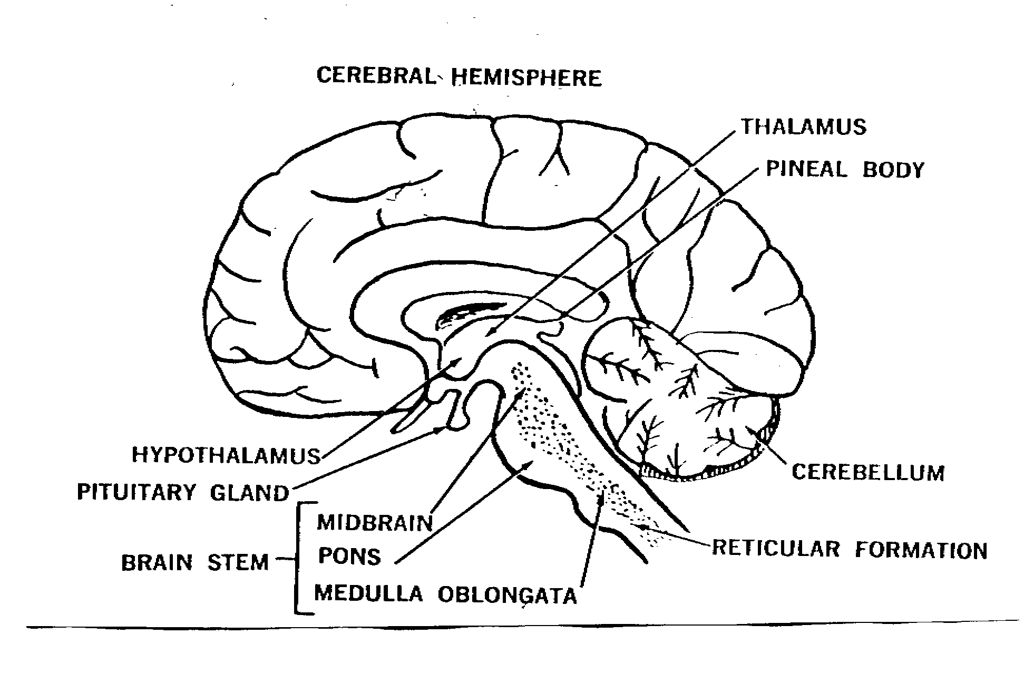
Guess the level!!

Slide 23
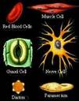
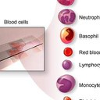

Slide 24
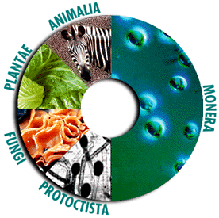
The 5 kingdoms

Slide 25
The Kingdoms
Monera- Bacteria and Cyanobacteria (Prokaryotic)- Unicellular –Autotrophic or heterotrophic.
Protoctist – Protozoa and Algae -Unicelullar and multicellular- No tissues – Autotrophic and heterotrophic
Fungi: Yeasts, Moulds, Mushrooms – unicellular and multicellular –No tissues –heterotrophic
Plant. Mosses, Ferns, Flowering plants – multicellular – tissues – autotrophic
Animals: vertebrate and invertebrates- multicellular –tissues - heterotrophic

Slide 26
Classification
Kingdom
Phyllum (it may have sub phyllum)
Class
Order
Family
Genus
Species (it may have subspecies)

Slide 27
What is a species?
It is a set of living beings which are physically similar, they reproduce and have fertile descendents.
Human being: Homo sapiens
Wolf: Canis lupus
Dog: Canis familiaris
Donkeys: Equus asinus
Horse: Equus caballus

