Slide 1
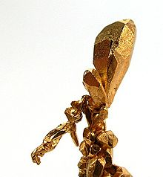
The geosphere
Minerals and rocks

Slide 2
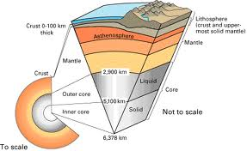
Geosphere

Slide 3
Minerals
Solid, natural, definite chemical composition, arrengement of atoms (crystals)
Silicates (quartz) and non-silicates (calcite)

Slide 4
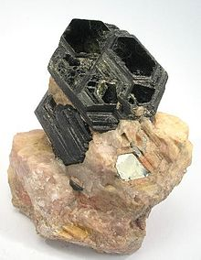
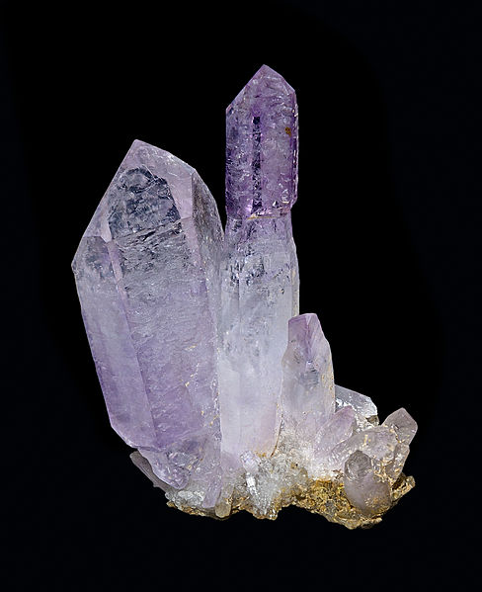
Some minerals: quartz and biotite

Slide 5
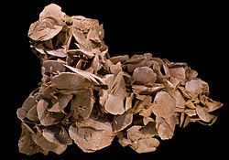
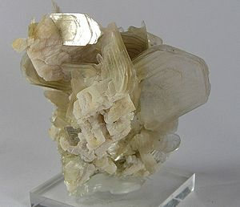
Some more: gypsum and muscovite

Slide 6
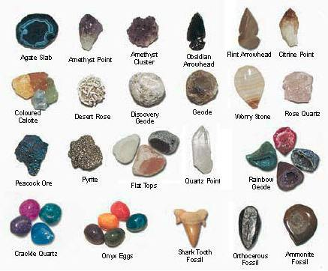

Slide 7
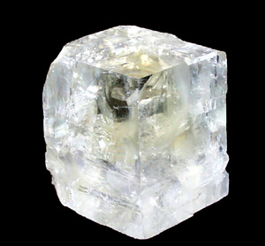
Calcite
Cubic shape
White (or creamy)

Slide 8
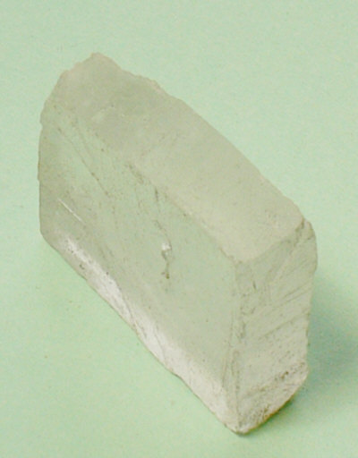
Halite
White and cubic (!)
Taste: salty (try)

Slide 9
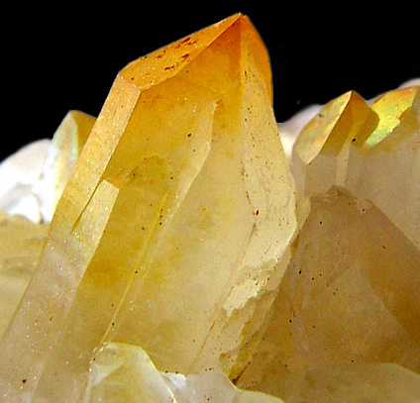
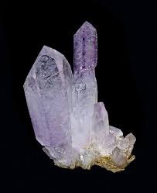
Quartz: easy to identify due to its shape…

Slide 10
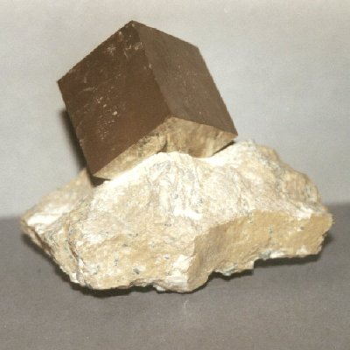
Pyrite: fool's gold (Fe S2)
Pale brass-yellow reflective
Cubic
Metallic luster
Hardness: 6–6.5
Density:4.8–5 g/cm³

Slide 11
Minerals lab
Name | colour | shape | luster | others
quartz
amatiste
halite
pyrite
calcite

